Slide 1
LOWER GIT BLEEDING
DR M D P PINTO
DEPARTMENT OF SURGERY
FOM
UOK
28 – 08 - 2018

Slide 2
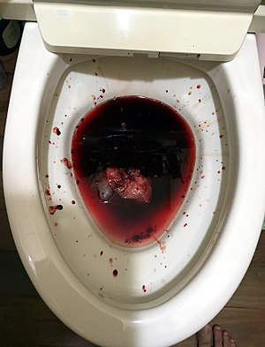
Introduction
Haematochezia
Passage of fresh blood through the anus, usually in or with stools
Shows lower GIT bleed – below the ligament of Treitz
Rarely acute massive upper GI bleed may give haematochezia
Needs further evaluation in all patients.

Slide 3
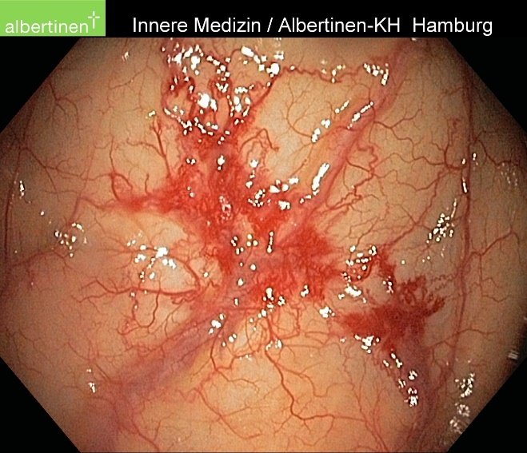
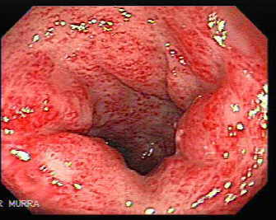
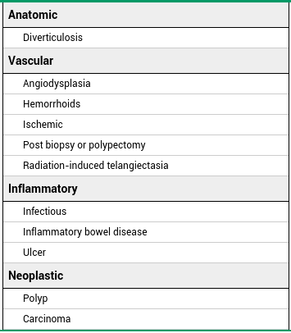
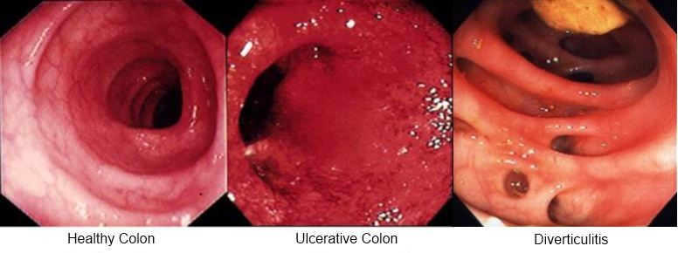
Causes
Angiodysplasia
Radiation proctitis

Slide 4
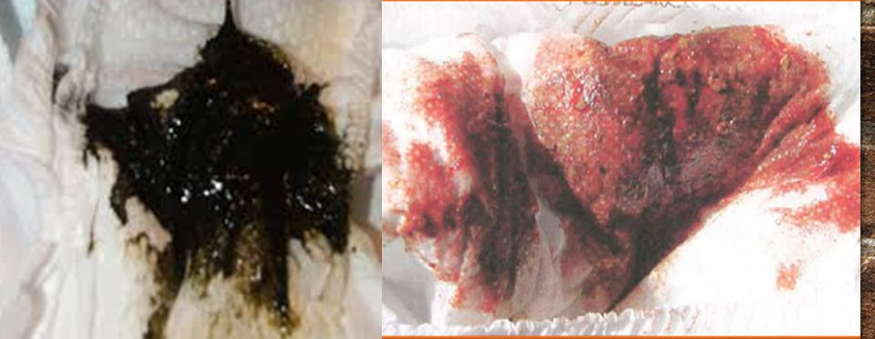
Melaena vs Haematochezia
Melaena
Upper GIT bleed
The black color and characteristic strong odor are caused by hemoglobin in the blood being altered by digestive enzymes and intestinal bacteria
Melaena is rarely seen with small intestinal or right colonic bleeds

Slide 5
Clinical assessment
Examination
Pallor, jaundice, built
Abdomen
Lumps
Ascites
Liver deposits
Previous incisions
DRE
Lungs – added sounds and effusion
Features of chemo/radio therapy
Specific features of pathologies
IBD – extra-intestinal manifestations
History
Age
Sex
Presenting complaint
Blood?
Onset, duration, intermittent or persisting, amount, relationship with stools – mixed/streaks/separately/following defaecation
Change in bowel habits
Cancer ?
Constitutional symptoms (LOA, LOW, evening pyrexia)
Risk factors
Complications – obstruction, anaemia
Already on treatment?
Re-evaluate for cancer in IBD

Slide 6
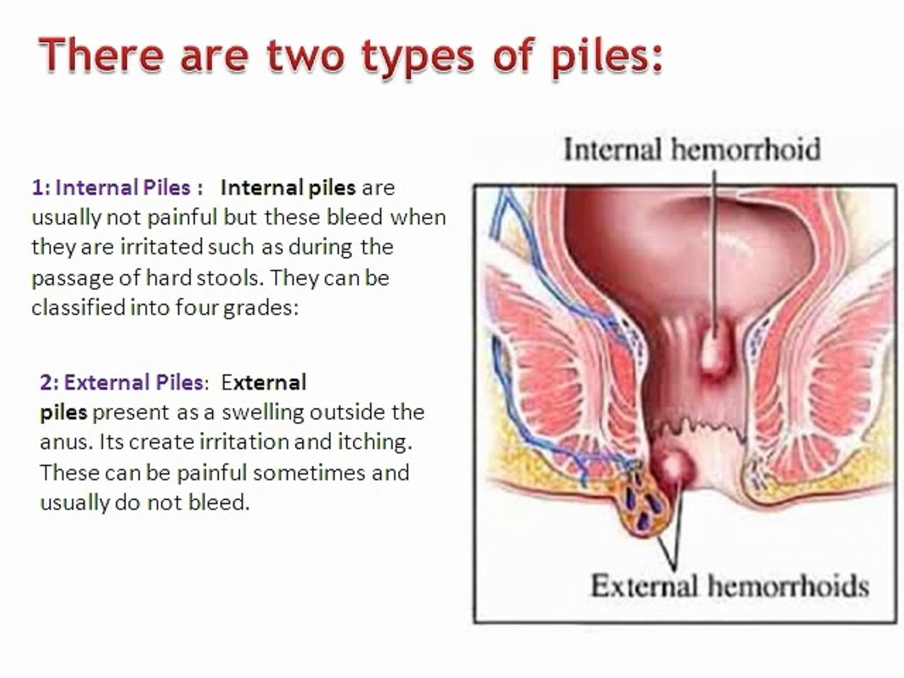
Haemorrhoids
Definition
Abnormal enlargement of normal vascular cushions of the anal canal.
Internal haemorrhoids
Origins from superior haemorrhoidal plexus
Arise above dentate line – viscerally innervated columnar epithelium – not pain sensitive
3 primary locations
3/7/11 o’ clock
External haemorrhoids
From inferior haemorrhoidal plexus
Covered by pain sensitive squamous epithelium (anoderm) = extremely painful when thrombosed

Slide 7
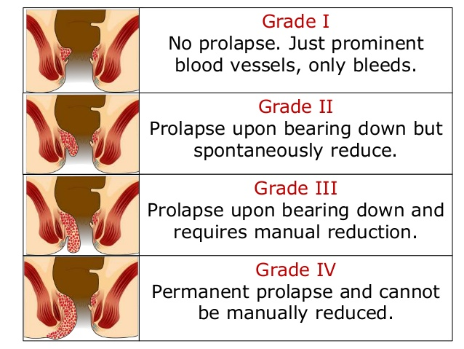
Haemorrhoids
Pathogenesis – multiple theories
Weakened anchoring connective tissue – bulge and slide into anal canal
Abnormal distension of AV anastomosis within the cushions – red bleed
Abnormal dilatation of veins of the haemorrhoidal plexus
Risk factors
Advancing age
Pregnancy
Pelvic tumours
Chronic constipation
Prolonged sitting

Slide 8
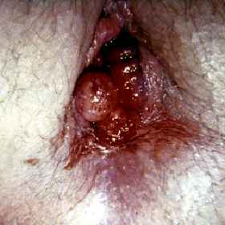
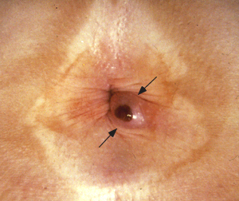
Haemorrhoids
PROLAPSED BLEEDING HAEMORRHOID
Clinical features
Painless bleeding associated with a bowel opening – bright red
Usually painless
Irritation and itching
Mild faecal incontinence
Thrombosed haemorrhoid
painful palpable perianal lump
Commoner in external haemorrhoids
THROMBOSED EXTERNAL HAEMORRHOID

Slide 9
Haemorrhoids
EXAMINATION
DRE – can’t feel haemorrhoids unless thrombosed
Proctoscopy
Endoscopy
Not indicated in <50y with no anaemia, no change in bowel habits or risk factors for CRC
Treatment
Initial approach – non operative
Grade 3/4 or symptomatic disease – intervention indicated
Irritation/ pruritus – warm sitz bath, hydrocortisone cream (1 week only)
Avoid constipation
Dietary – high fibre/ 2l water per day
Laxatives
Thrombosed – warm sitz baths, analgesia → if very painful or not resolving by 10days = excision

Slide 10
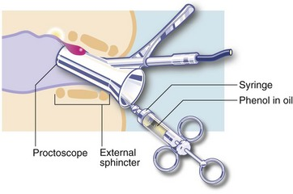
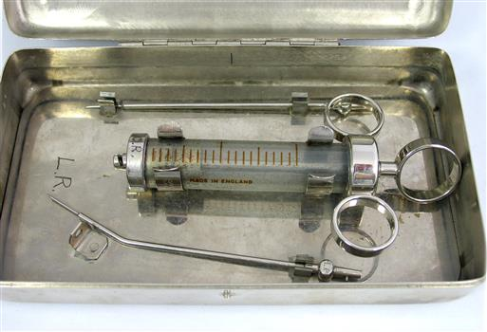
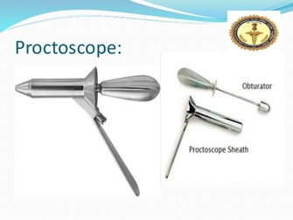
Haemorrhoids
Proctoscopic 5% phenol in almond oil/ sodium tetradecyl sulphate injection – grade 1/2
Endoscopic band ligation for grade 2/3
Open haemorrhoidectomy
Stapled haemorrhoidectomy
Haemorrhoidal artery ligation (HAL)
GABRIEL SYRINGE

Slide 11
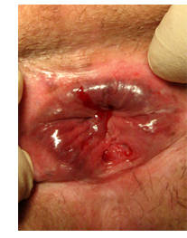
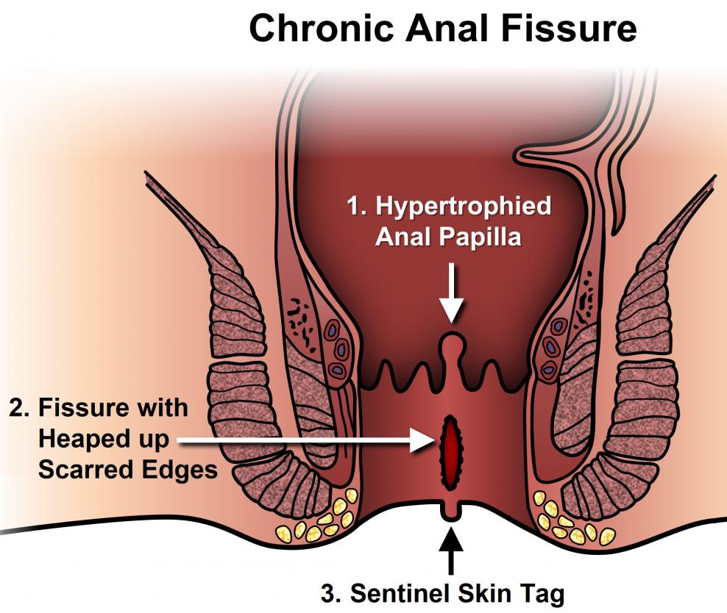
Anal fissure
Acute anal fissure
Definition
Tear in distal anoderm
More than 90% in 6 o’ clock position – least perfused region of anal verge
Pathogenesis
Tear caused primarily by local trauma – constipation, diarrhoea, NVD, anal sex
Tear caused secondary to malignancy, IBD, TB, HIV
Acute fissure →Triggers cyclic pain and bleeding → exposed internal sphincter goes into spasm → ischaemia →→→chronic fissure (40%)

Slide 12
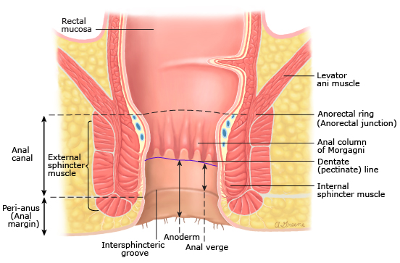
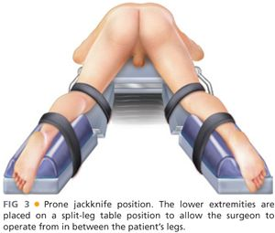
Anal fissure
Clinical features
Anal pain
Pain at rest, severe exacerbation by defaecation
Lasts hours after defaecation
Anal bleeding
Examination
DRE is contraindicated at initial visit – causes severe pain
Streaks of blood on stools
Observe anus in prone jack knife position
Acute fissure – fresh, superficial laceration
Chronic fissure – skin tag hiding the fissure, raised edges

Slide 13
Anal fissure
Medical management – for primary fissures
Fiber diet – soften and bulk up stool
Laxatives
Avoid straining
Sitz bath
Relaxes sphincter – reduce spasms and ischaemia
Topical analgesia
2% lidocaine jelly – can mix with vasodilator cream
Topical vasodilators
0.2% Nifedipine BD – reduces anal sphincter tone
0.4% Nitroglycerin BD – improve local blood flow + pressure
Nitroglycerin cream can give headaches! – resolves after 2/52
Endoscopy
Colonoscopy – more than 50ysigmoidoscopy – less than 50y with no risk factors for CRC
Prevention
Avoid diarrhea, constipation
High fiber diet
Avoid habitual straining at bowel opening

Slide 14
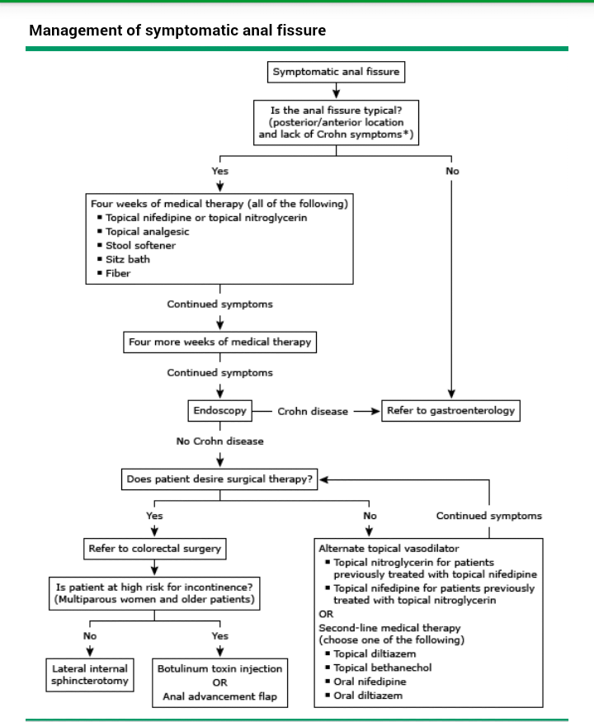

Slide 15
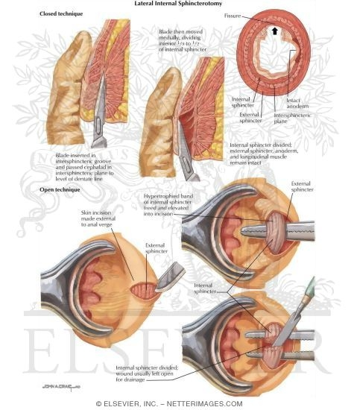
Anal fissure – surgical management
For refractory disease
If high risk of incontinence (older/few NVDs) – Botulinum toxin injection / anal advancement flap
Low risk of incontinence – lateral sphincterotomy (open anoderm and excise internal sphincter completely – some chance of gas incontinence)

Slide 16
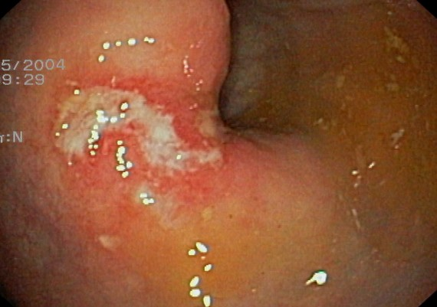
Solitary rectal ulcer
Uncommon cause of rectal bleeding – 1:100,000
Misnomer - Can be an ulcer, mucosal erythema or polyp
Pathogenesis – not clear
Prolapsed mucosa pushed down when straining and paradoxical puborectalis pull back → mucosal ischaemia → ulcer
Present with bleeding, sense of incomplete evacuation, rectal prolapse
Diagnosis
Endoscopic appearance not specific
Histology – specific
Fibromuscular obliteration of LP
Treatment
Non operative measures – laxatives/ dietary fiber
Operative – local excision, rectopexy, faecal diversion

Slide 17

Angiodysplasia
Most common vascular anomaly in GIT
Common in elderly, vWD, end stage CKD, AS (Heyde syndrome)
Pathogenesis
Commonly in colon – mostly caecum
Dilated, thin walled vessels
Happen due to recurrent, low grade obstruction of submucosal veins
Presentations
Incidental finding or PR bleed – sometimes life threatening
Treatment
Endoscopic cautery - APC/ bipolar
Angiographic embolization
Surgical - colectomy

Slide 18
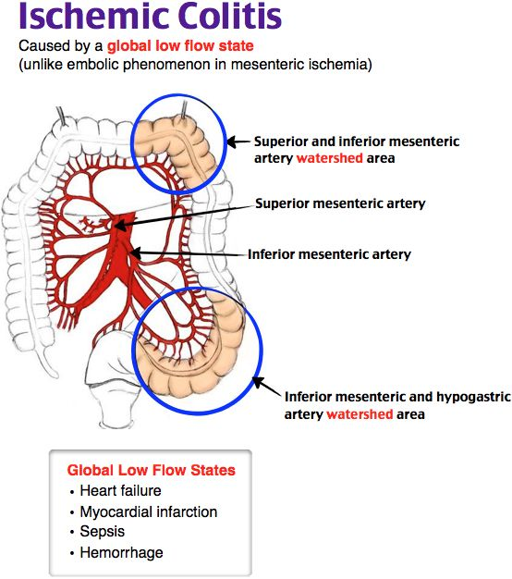
Ischaemic colitis
Colonic ischaemia – in elderly with episodes of hypotension, arrhythmias
Cramping pain mostly in the left side, PR bleed
Diagnosis by clinical findings and CECT
Definitive mx – segmental resection

Slide 19
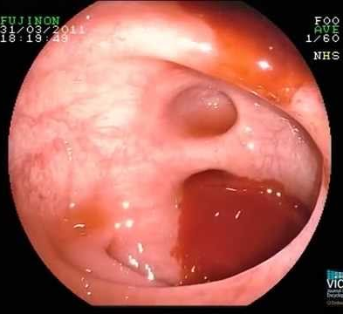
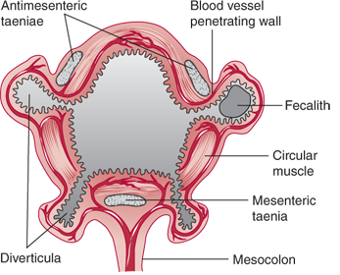
Diverticular disease
Sac like protrusion of the colonic wall at vasa recta penetrating circular muscle layer of colon
Common in elderly of the western world
In Asians diverticula are more on right side of colon
Bleeding due to;
Vasa recta damage and painless PR bleed
Diverticulitis
Diagnosis by colonoscopy
Management
Resuscitation
Endoscopic therapy – 4 quadrant submucosal epinephrine injection/ bipolar coagulation
Angiographic embolization
Segmental colectomy if not settled

Slide 20
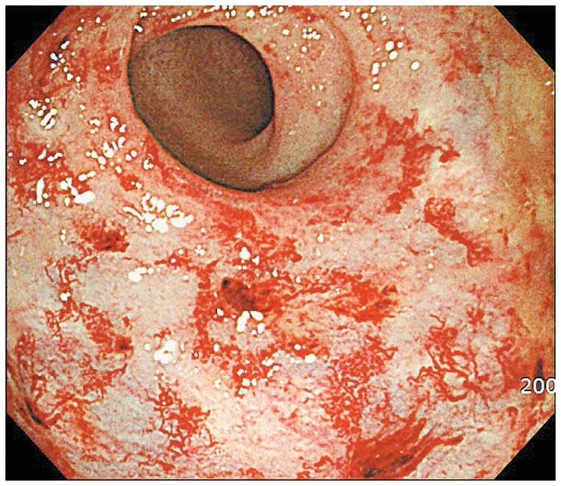
Radiation colitis/ proctitis
Acute proctitis – within 6/52 of therapy – due to direct mucosal damage
Chronic proctitis – delayed onset after 1year up to 30years – due to obliterative endarteritis and resulting ischaemia and fibrosis
Symptoms
PR bleed
Anal pain
Tenesmus
Mucus discharge
Diagnosis – endoscopy and biopsy
Treatment
Supportive therapies – analgesia, laxatives, hydrocortisone enema 100mg BD
Endoscopic APC/ RFA/ Formalin
Surgery – if intractable symptoms
Proctectomy
Diversion loop colostomy

Slide 21
Not discussed
IBD
Neoplasia
Pseudomembranous colitis

Slide 22
Thank you
Questions ?
askpinto@yahoo.com

